Slide 1
Defining our performance objective
F427: ML & AI in Investing

Slide 2
Defining our performance objective
What does it mean to outperform the S&P MidCap 400?
Portfolio performance
Total returns vs benchmark
Standard deviation (monthly and annualized)
Sharpe ratio
Alpha
One-factor model regression in Python
Investment fund
One stock
Many stocks

Slide 3
Portfolio: Total returns vs benchmark
Let’s illustrate portfolio performance using the Invesco S&P MidCap Quality ETF.
Ticker = XMHQ
ISIN = US46137V4721
CUSIP = 46137V472
Launch = December 1, 2006
Summary from Factset is below
Description: XMHQ tracks the S&P mid-cap 400 Quality Index, which screens stocks based on fundamental factors and weights them using a multi-factor approach.
Fund Insight: XMHQ is a passively-managed portfolio of 80 securities that tracks the S&P mid-cap 400 Quality Index. The equities are selected based on the highest quality score, calculated by the following three equally-weighted fundamental factors: (1) return-on-equity (2) accruals ratio, and (3) financial leverage ratio. The index is being weighted by the total of its quality score multiplied by its market capitalization and is rebalanced semi-annually. Prior to June 24, 2019, the fund traded as Invesco Russell mid-cap Equal Weight ETF (EQWM) and followed the Russell mid-cap Equal Weight Index.

Slide 4
Total returns since inception (Dec 1, 2006)
Price return:
231%
7.7% per year
NAV return:
225%
7.6% per year
S&P MidCap 400:
299%
7.0% per year
MCSI US MidCap 450:
281%
8.7% per year

Slide 5
Monthly volatility
Over 16 years and 1 month, monthly returns from -22.1% to 14.6% with an average of 0.76% and standard deviation of 5.15%.

Slide 6
Geometric mean returns and monthly volatility
Over 16 years and 1 month, monthly returns from -22.1% to 14.6% with a geometric average of 0.63% and standard deviation of 5.15%.
Better reward for risk trade-off than the S&P 400 MidCap.
The reward-for-risk trade-off is neither better nor worse than the MSCI MidCap.
If an investor prefers higher return and higher risk, the MSCIMid is better.
If an investor prefers lower return and lower risk the Invesco fund is better.

Slide 7
Return and volatility summary
Arithmetric vs geometric mean returns:
Arithmetric mean returns used as an estimate of future returns when the past returns distribution is considered an unbiased estimate of the future returns distribution
Geometric mean returns show what an investor actually earned.
Discrete time returns vs continuously-compounded returns (i.e. log returns):
Discrete time return = Future value/Present value – 1 (what investors typically use)
Continuously-compounded return = LN (Future value/Present value) (used in option pricing and to mitigate outlier influence)
1 | Invesco | S&P | MSCI
Discrete time returns
Monthly average return | 0.76% | 0.72% | 0.84%
Monthly average return annualized | 9.52% | 9.01% | 10.57%
Geometric mean return per month | 0.63% | 0.57% | 0.70%
Geometric mean return per year | 7.78% | 7.08% | 8.70%
Monthly standard deviation of returns | 5.15% | 5.43% | 5.30%
Standard deviation of returns annualized | 19.54% | 20.54% | 20.30%
Continuously-compounded returns (i.e. log returns)
Monthly average log returns | 0.62% | 0.57% | 0.70%
Monthly average log returns annualized | 7.49% | 6.84% | 8.34%
Geometric mean return per month | 0.62% | 0.57% | 0.70%
Geometric mean return per year | 7.49% | 6.84% | 8.34%
Monthly standard deviation of log returns | 5.22% | 5.53% | 5.40%
Standard deviation of log returns annualized | 18.07% | 19.15% | 18.70%
Arithmetric & geometric avg returns
Arithmetic avg = Sum (ret) / mths
Geometric avg (disc)
= [Product (1 + ret)]^{1/mths} – 1
Geometric avg (cont) = same as arith avg
Equations to convert monthly returns to annualized returns.
Discrete time returns:
Avg ret per year = (1 + avg ret per mth)¹² – 1
SD per year
= SQRT {[SD per mth² + (1 + Avg ret per mth)²]¹² – [1+Avg ret per mth]²⁴}
Continuously-compounded returns:
Avg ret per year = Avg ret per mth × 12
SD per year = SD per mth × SQRT (12)

Slide 8
Volatility and the Sharpe ratio
Sharpe ratio is the slope of the line between two points: a proxy for the risk-free rate & a portfolio.
The risk-free rate in the example is the yield on a 1-mth treasury bill at the start of each month.
The risk-free rate is time-varying in the example (in theory, when the Sharpe ratio was devised, there was only one time period).
The term “excess return” means return minus the risk-free rate.
The term “abnormal return” means return minus a fair return for risk, often measured using an index of estimated equivalent risk.
Sharpe ratio = Average excess return ÷ Standard deviation of excess return
The Sharpe ratio is typically estimated with wide margin for error because portfolio volatility is high and the time series is short (low signal to noise ratio)
So buying funds merely because they have a high Sharpe ratio will not necessarily lead to high future performance
Ask whether the investment strategy is repeatable and analyze whether the fund benefitted from one-off events.

Slide 9
A factor model of excess returns
The Invesco fund offers exposure to midcap stocks, and industry- and company-specific exposure.
Regressing excess returns of the fund against excess returns of a midcap index generates information allowing us to measure exposure to the “midcap factor” and, on average, alpha (the intercept, which represents average monthly returns from industry- and company-specific deviations from the benchmark).
The theoretical model is:
(Fund return in month t – Risk-free rate in month t) = Intercept + Coefficient 1 × (Midcap index return in month t – Risk-free rate in month t) + Error in month t (also called the residual in month t and often written as epsilon_{t}, ε_{t})
Using the S&P 400 index as the benchmark the empirical model is:
Invesco excess return in month t = 0.09% + 0.92 × S&P 400 excess return in month t + ε_{t}
Using the MSCI 450 index as the benchmark the empirical model is:
Invesco excess return in month t = –0.04% + 0.94 × MSCI 450 excess return in month t + ε_{t}

Slide 10
Capital Asset Pricing Model
The most well-known factor model is the Capital Asset Pricing Model
Developed by Sharpe, Linter and Mossin in 1964 and 1965 and tested for 60 years.
The left hand side is excess returns on any asset.
The right hand side is excess returns on the market portfolio of all risky assets (stocks, bonds, property, art, wine), typically proxied by a broad stock market index for ease of measurement.
Coefficient 1 is “beta”, a measure of the asset return’s exposure to systematic risk (also termed market risk or economic risk). The model is presented below using monthly returns.
Asset return in month t – Risk-free rate in month t = Intercept + Beta × (Return on the market portfolio of all risky assets in month t – Risk-free rate in month t) + Error in month t
The model has limitations: it is biased, imprecise and incomplete. These limitations are present because the model relies upon assumptions that are violated in reality, including that investors can borrow and lend at the risk-free rate of interest, there are no liquidity constraints, and investors have the same, complete information set.
Our measurement of market returns in later work will be those appearing on Professor Ken French’s website: http://mba.tuck.dartmouth.edu/pages/faculty/ken.french/index.html
This is handy because the website also has monthly returns on other factors, which allows us to illustrate multi-factor models.

Slide 11
Invesco regression in Python
# Import libraries import matplotlib.pyplot as plt import numpy as np import pandas as pd import statsmodels.api as sm from sklearn.metrics import r2_score # Change the number of rows and columns to display pd.set_option('display.max_rows', 200) pd.set_option('display.max_columns', 20) pd.set_option('display.max_colwidth', 50) pd.set_option('display.precision', 4) # Define a path for import and export path = 'F:\\UM\Courses\\FIN427\\FIN427 Winter 2023\\' # Import monthly returns data df_returns = pd.read_excel(path + 'Excel 02 Invesco MidCap Quality 20230104.xlsx', sheet_name='MthData') print(df_returns.head()) df_returns = df_returns.dropna() print(df_returns.head())
# For comments and switched off code
Libraries
Options to display the number of rows and columns, column width and precision of displayed variables. Does not change data.
Path
Import data
Observe the first 5 rows
Drop Nan (“not a number”)
Can create a new dataframe or adjust the original dataframe
Observe the first 5 rows again

Slide 12
Invesco regression in Python
# Regression of Invesco excess returns on S&P 400 excess returns y = df_returns['InvescoMidQualExRet'] x = df_returns[['SP400ExRet']] x = sm.add_constant(x) model = sm.OLS(y, x).fit() predictions = model.predict(x) print_model = model.summary() print(print_model) print(predictions) # Regression using polyfit x1 = df_returns.SP400ExRet y1 = df_returns.InvescoMidQualExRet m, b = np.polyfit(x1, y1, 1) print("Slope: " + str(round(m, 3))) print("Coefficient: " + str(round(b, 6))) plt.plot(x1, y1, 'o') plt.plot(x, m * x + b, 'red', label='Invesco excess returns = {:.4f} + {:.2f} x S&P 400 MidCap Excess returns'.format(b, m)) plt.legend(loc='lower right') plt.xlabel('S&P MidCap 400 excess returns') plt.ylabel('Invesco excess returns') plt.xlim([-0.25, 0.25]) plt.ylim([-0.25, 0.25]) plt.savefig(path + 'Invesco scatter vs S&P 400.jpg') plt.show()
Create a dataframe of dependent variables
Create a dataframe of independent variables
Include a constant in the independent variables
Define the model as ordinary least squares with x and y variables
Generate predictions for Invesco excess returns
Create a model summary and print
Print the predictions
Create a dataframe of independent variables
Create a dataframe of dependent variables
Model the linear regression
Print the slope
Print the intercept
Plot the independent and dependent variables as circles
Plot the line of best fit in red including a legend located in the lower right
Add labels to the chart
Define the width of the x and y axes.
Export the chart
Show the chart

Slide 13
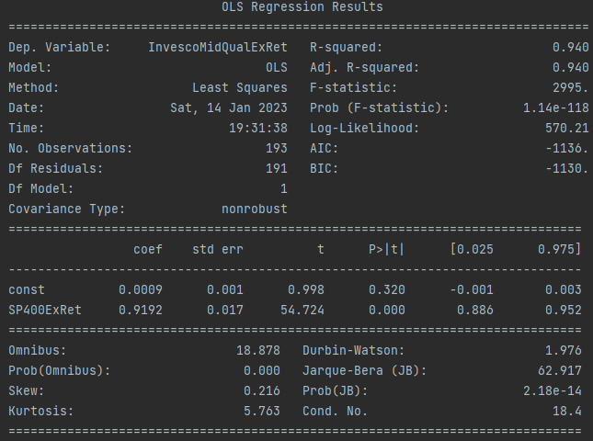
Invesco regression in Python
Alpha = 0.09% per mth
Exposure to S&P MidCap = 0.92
R-square = 94%
Std error of alpha = 0.1%
+/- 1 SD = -0.01% to +0.19% pm
~ -0.1% to +2.3% per year
N = 193 mths
DW = 1.98 (~2)
implying no time series correlation of errors (if errors are correlated in time the standard error will be understated)
Residuals have low skewness (0.2)
… but have high kurtosis (5.8 vs exp value of 3)
… and the JB test with low p-value says residuals are not normally distributed
… which is a flag that we should check for outlier returns.

Slide 14
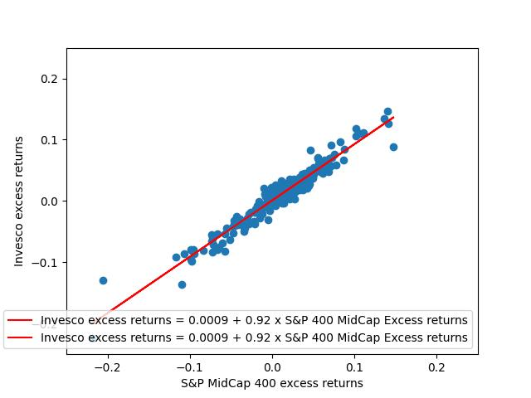
Invesco regression in Python
We will conduct more formal outlier tests later. But observe the influential observations.
S&P 400 excess returns of 14.7% & Invesco excess returns of 8.9% in April 2009.
S&P 400 excess returns of -20.6% & Invesco excess returns of -12.9% in March 2020.
These datapoints decrease the slope and increase the intercept which might mean that alpha of 0.9% per month is overstated.
If just these two data points are removed the slope increases to 0.96 and alpha decreases to 0.6% per month.
Dealing with influential observations is more important than formal statistical tests.

Slide 15
Estimating individual stock index exposure
# Import libraries import matplotlib.pyplot as plt import numpy as np import pandas as pd import statsmodels.api as sm from sklearn.metrics import r2_score # Define a path for import and export path = 'F:\\UM\Courses\\FIN427\\FIN427 Winter 2023\\' # Import monthly returns for individual S&P 400 stocks df_stockret = pd.read_excel(path + 'Excel02 S&P 400 historical returns 20221231.xlsx', sheet_name='mth') print(df_stockret.head()) print(df_stockret.columns) # Import monthly returns on the S&P 400 index df_indexret = pd.read_excel(path + 'Excel02 S&P 400 Returns 20221230.xlsx', sheet_name='Mth') df_indexret['MthRet'] = df_indexret['RetInd'].pct_change() print(df_indexret.head()) print(df_indexret.columns) # Import monthly Fama and French factors df_ff = pd.read_excel(path + 'Excel02 Fama and French 20230114.xlsx', sheet_name='Mth3') print(df_ff.head()) print(df_ff.columns)
Compute percentage change in index levels.

Slide 16
Estimating individual stock index exposure
# Combine stock return data with index return data and Fama-French data df_combret1 = pd.merge(df_stockret, df_indexret, left_on='MthEnd', right_on='MthEnd') df_combret2 = pd.merge(df_combret1, df_ff, left_on='MthEnd', right_on='MthEnd') df_combret2 = df_combret2.dropna() # Compute excess returns df_combret2['StockretRf'] = df_combret2['RET'] - df_combret2['Rf'] df_combret2['IndexretRf'] = df_combret2['MthRet'] - df_combret2['Rf'] # Remove a company with only two observations df_combret3 = df_combret2.loc[df_combret2['CUSIP'] != '55919410'] print(df_combret3.head()) print(df_combret3.columns)
Merge could be done in one step.
Dropna to remove observations with missing data.
Computation of excess returns.
Removal of a company (obviously we would need to be more systematic when we are dealing with many anomalous companies).

Slide 17
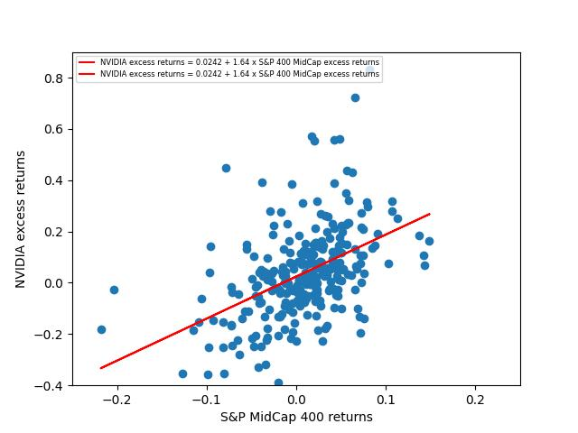
Estimating individual stock index exposure
# Example regression for one company - NVIDIA # Selecting rows based on condition TestCUSIPS2 = ['67066G10'] df_combret4 = df_combret3[df_combret3['CUSIP'].isin(TestCUSIPS2)] print(df_combret4.head()) print(df_combret4.columns) y = df_combret4['StockretRf'] x = df_combret4[['IndexretRf']] x = sm.add_constant(x) model = sm.OLS(y, x).fit() predictions = model.predict(x) print_model = model.summary() print(print_model) print(predictions) # Regression using polyfit x1 = df_combret4.IndexretRf y1 = df_combret4.StockretRf m, b = np.polyfit(x1, y1, 1) print("Slope: " + str(round(m, 3))) print("Coefficient: " + str(round(b, 6))) plt.plot(x1, y1, 'o') plt.plot(x, m * x + b, 'red’, label='NVIDIA excess returns = {:.4f} + {:.2f} x S&P 400 MidCap excess returns' .format(b, m)) plt.legend(loc='upper left', fontsize=6) plt.xlabel('S&P MidCap 400 returns') plt.ylabel('NVIDIA excess returns') plt.xlim([-0.25, 0.25]) plt.ylim([-0.40, 0.90]) plt.savefig(path + 'Chart02 NVIDIA beta.jpg') plt.show()
Selection of observations according to a condition is the only new code in this section. The rest of the code is identical to the code from the Invesco analysis (albeit with different inputs).
Imagine selecting a subset of companies for analysis that met some criteria.
NB “isin” means “is in” and is not the company identifier ISIN.

Slide 18
Estimating individual stock index exposure
# Example regression for 3 companies - NVIDIA, Qualcomm and AMD TestCUSIPS3 = ['67066G10', '74752510', '00790310'] df_combret5 = df_combret3[df_combret3['CUSIP'].isin(TestCUSIPS3)] def regress(df_combret5, yvar, xvars): y3 = df_combret5['StockretRf'] x3 = df_combret5['IndexretRf'] x3 = sm.add_constant(x3) model3 = sm.OLS(y3, x3).fit() predictions3 = model3.predict(x3) r2 = r2_score(y3, predictions3) return model3.params, r2 output3 = df_combret5.groupby('CUSIP').apply(regress, yvar='y3', xvars=['x3']) print(output3)
With many companies to analyze, we can define a function (“regress”) and apply that function to many companies.

Slide 19
Estimating individual stock index exposure
# Example regression for 3 companies - NVIDIA, Qualcomm and AMD TestCUSIPS3 = ['67066G10', '74752510', '00790310'] df_combret5 = df_combret3[df_combret3['CUSIP'].isin(TestCUSIPS3)] def regress(df_combret5, yvar, xvars): y3 = df_combret5['StockretRf'] x3 = df_combret5['IndexretRf'] x3 = sm.add_constant(x3) model3 = sm.OLS(y3, x3).fit() predictions3 = model3.predict(x3) r2 = r2_score(y3, predictions3) return model3.params, r2 output3 = df_combret5.groupby('CUSIP').apply(regress, yvar='y3', xvars=['x3']) print(output3) # Running the regression on all companies def regressall(df_combret3, yvar, xvars): yall = df_combret3['StockretRf'] xall = df_combret3['IndexretRf'] xall = sm.add_constant(xall) modelall = sm.OLS(yall, xall).fit() predictionsall = modelall.predict(xall) r2all = r2_score(yall, predictionsall) return modelall.params output = df_combret3.groupby('CUSIP').apply(regressall, yvar='yall', xvars=['xall']) print(output)
With many companies to analyze, we can define a function (“regress” and later “regressall”) and apply that function to many companies.
I apply a function to a dataframe of 3 companies and then a dataset of all companies.

Slide 20
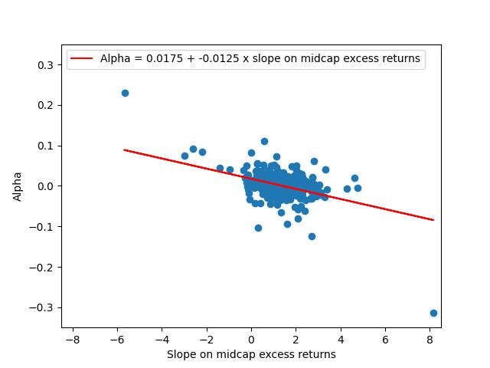
Estimating individual stock index exposure
# Regression to show the inverse relationship between estimates of alpha and index exposure x4 = output.IndexretRf y4 = output.const m, b = np.polyfit(x4, y4, 1) print("Slope: " + str(round(m, 3))) print("Coefficient: " + str(round(b, 6))) plt.plot(x4, y4, 'o') plt.plot(x4, m * x4 + b, 'red', label='Alpha = {:.4f} + {:.4f} x slope on midcap excess returns' .format(b, m)) plt.legend(loc='upper left', fontsize=10) plt.xlabel('Slope on midcap excess returns') plt.ylabel('Alpha') plt.xlim([-8.5, 8.5]) plt.ylim([-0.35, 0.35]) plt.savefig(path + 'Chart02 Alpha and beta.jpg') plt.show() # Export results to Excel with pd.ExcelWriter(path + 'Excel02 Beta estimates 20230114.xlsx') as writer: output3.to_excel(writer, sheet_name='Coefficients 3') output.to_excel(writer, sheet_name='Coefficients All')
The all companies regression generates 1512 estimates of alpha and exposure to midcap excess returns (the slope; we can call it beta for convenience but remember it is NOT the CAPM beta because the factor was not the market return factor as the midcap index is not a proxy for the entire market).
Noise causes an inverse relationship between estimated alpha and estimated beta. In theory, alpha is independent of factor exposure. But any noise that causes an increase in the beta estimate
(i.e. high stock returns that by chance coincide with high index returns) also causes a decrease in the alpha estimate. So a company or investment fund can appear to have earned returns above its risk exposure, merely due to chance.

